Slide 1

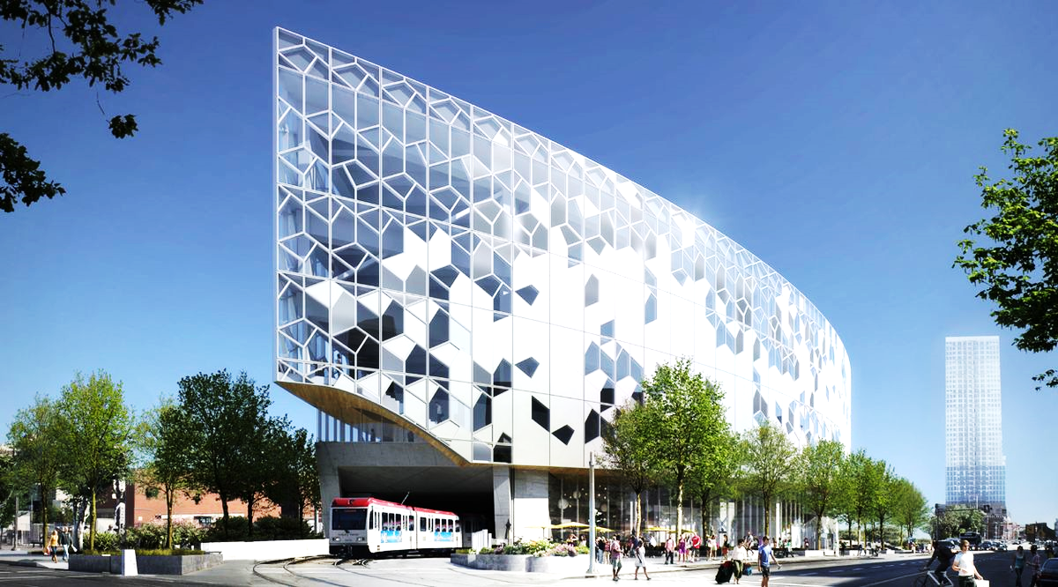







CALGARY
Register
https://GPPB2020-calgary.eventbrite.ca
Feb 15, 2020
Microsoft Canada, 110 9 Ave SW #710
Visit
https://www.powerplatformbootcamp.com
Follow
@GPPBootcamp #GPPB2020
Free Event

Slide 2

Toronto
Register
https://GPPB2020-calgary.eventbrite.ca
Feb 15, 2020
Visit
https://www.powerplatformbootcamp.com
Microsoft Canada, 110 9 Ave SW #710
Follow
@GPPBootcamp #gppb
Free Event

Slide 3
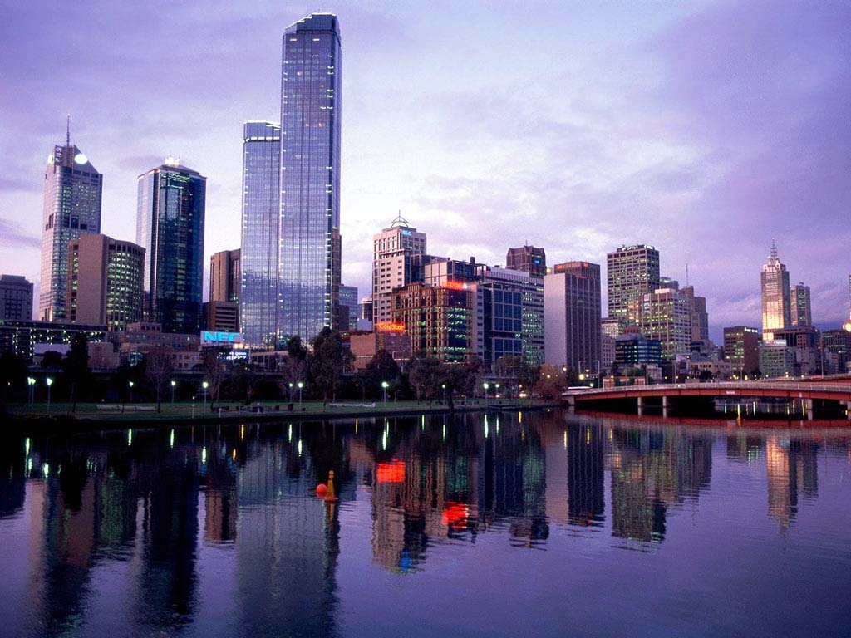
MELBOURNE
Register
https://GPPB2020-calgary.eventbrite.ca
Feb 15, 2020
Visit
https://www.powerplatformbootcamp.com
Microsoft Canada, 110 9 Ave SW #710
Follow
@GPPBootcamp #gppb
Free Event

Slide 4

CALGARY
Register
https://GPPB2020-calgary.eventbrite.ca
Feb 15, 2020
Visit
https://www.powerplatformbootcamp.com
Microsoft Canada, 110 9 Ave SW #710
Follow
@GPPBootcamp #gppb
Free Event

Slide 5
OTTAWA
Register
https://GPPB2020-calgary.eventbrite.ca
Feb 15, 2020
Visit
https://www.powerplatformbootcamp.com
Microsoft Canada, 110 9 Ave SW #710
Follow
@GPPBootcamp #GPPB2020
Free Event

